Slide 1
Literary Devices
Figurative Language &
Figures of Speech

Slide 2
Metaphor
Comparing two unlike objects
FORMAT:
(something) is (something else)
EXAMPLES:
He is an angel
She was a rock
They are not actually those things, they just have a similar quality

Slide 3
Simile
Comparing two objects using “like” or “as”
FORMAT:
_________ was as ________ as
_________ is like __________
EXAMPLES:
He was a like a movie star, with glistening white teeth
She was as strong as an ant, which is actually really strong
Similes clearly express a similar quality

Slide 4
Personification
Giving human qualities to non-human things
FORMAT:
No specific format
May be combined with other literary devices
EXAMPLES:
The little dog laughed
The flowers waved in the wind
Because they are not human, they cannot have human actions

Slide 5
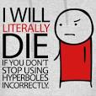
Hyperbole
An exaggeration
FORMAT:
No specific format
May be combined with other literary devices
EXAMPLES:
She was smarter than everyone in the room, just like Einstein
His smile was brighter than the sun
They are not actually those things, they just have a similar quality

Slide 6
Onomatopoeia
Sound words
Words to represent actual sounds
FORMAT:
No specific format, but can sometimes be written in CAPITAL LETTERS
EXAMPLES:
BANG!
BOP! BAM! ZOWIE!!
The duck said “Quack.”
You often find these in comic strips

Slide 7
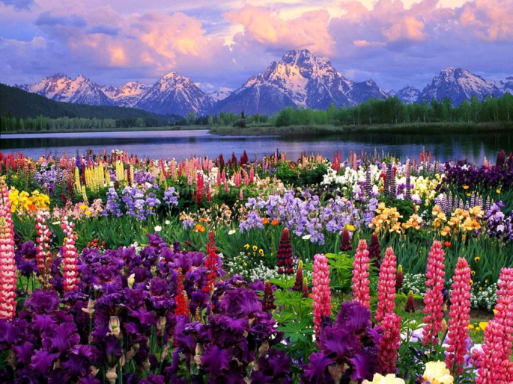
Imagery
Words used to create or describe something in detail
Often used with other literary devices
FORMAT:
No specific format
EXAMPLES:
He is an angel
She was a rock
They are not actually those things, they just have a similar quality
The sunset was painted across the sky. The flowers smiled, even though their beauty almost paled next to magnificent sky.

Slide 8
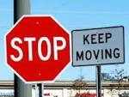
Oxymoron
Two opposites, put together to express an idea
Often used to describe something, can be similar to a metaphor
FORMAT:
Format can vary
He was ____________________
EXAMPLES:
Big baby
Giant Shrimp
Brilliant Idiot
The two opposites both apply in explaining something

Slide 9
Alliteration
Repetition of the same beginning sound of a word, at least 3 times
FORMAT:
_________ _________ ______
EXAMPLES:
Big, beautiful bumblebees
Round, rattling and ruffled…
Think like Dr. Seuss!
The words can be descriptors, or a combination of word types

Slide 10
Idioms
An expression in English, that doesn’t mean what it sounds like it should mean
FORMAT:
Format can vary
EXAMPLES:
He was walking on thin ice
Drama was not her cup of tea
Can be very descriptive, but sometimes won’t make sense to people who haven’t heard them before

